Slide 1
CITY OF BRUNSWICK Public Hearing for the community development block grant program (CDBG)
FY2024-2025 Action plan

Slide 2
FY 2024-2025 Action Plan
Each year the City of Brunswick prepares an Action Plan to describe to the public (and HUD) how it intends to spend its annual allocation. This is the fifth and final year of the five-year cycle
Entitlement
FY2024-2025 CDBG Allocation: $412,000 (approximate)
HUD’s fiscal year begins July 1, 2024, and ends June 30, 2025
One overarching goal is to make lasting impacts in the community; selected projects will benefit the City of Brunswick for many years

Slide 3
PROPOSED BUDGET
Housing Rehabilitation $219,000
Improve Public Facilities $ 26,000
Public Services $ 60,000
Remove Slum and Blight $ 60,000
Provide Fair Housing Education and Outreach $ 2,000
Planning and Administration of the CDBG Program $ 45,000
Total: $412,000

Slide 4
Projects, allocations and goals

Slide 5
1) Planning and administration
Goal description: To cover administrative expenses such as salaries, equipment, etc
Allocation - $45,000 (approximate)
The allocation pays for a portion of salaries, the city covers the remaining balance
Grantee: N/A

Slide 6
2) Housing rehabilitation including accessibility improvements: Minor/Major Home Repair (MMH)
Goal description: To preserve and rehabilitate affordable housing (single and multi-family)
Allocation - $219,000 (approximately)
eight or more housing units to be rehabilitated by replacing roofs, HVAC units, windows, etc.
Grantees: TBD

Slide 7
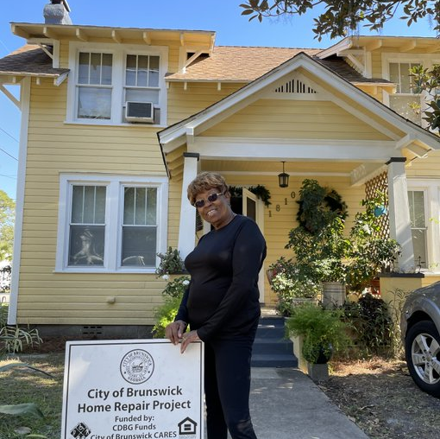
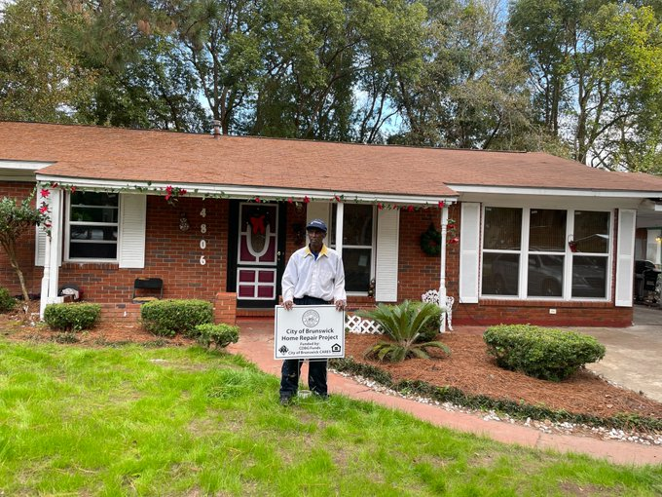

Slide 8
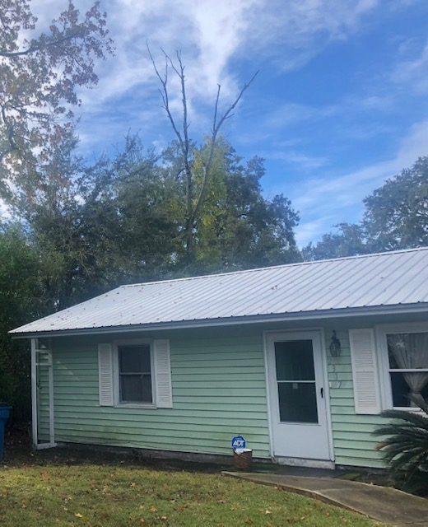

Slide 9
3) Public Services
Goal description: To support youth, senior and homeless services, after-school programs and summer programs
Allocation - $60,000 (approximate)
Five to six non-profits
Grantee: TBD

Slide 11
4) Public Facilities
Goal description: To provide funding for public infrastructure projects such as sidewalks, fencing, repaving parking lots, water and sewage, etc
Allocation - $26,000 (approxiamate)
One public facility project
Grantee: TBD

Slide 12
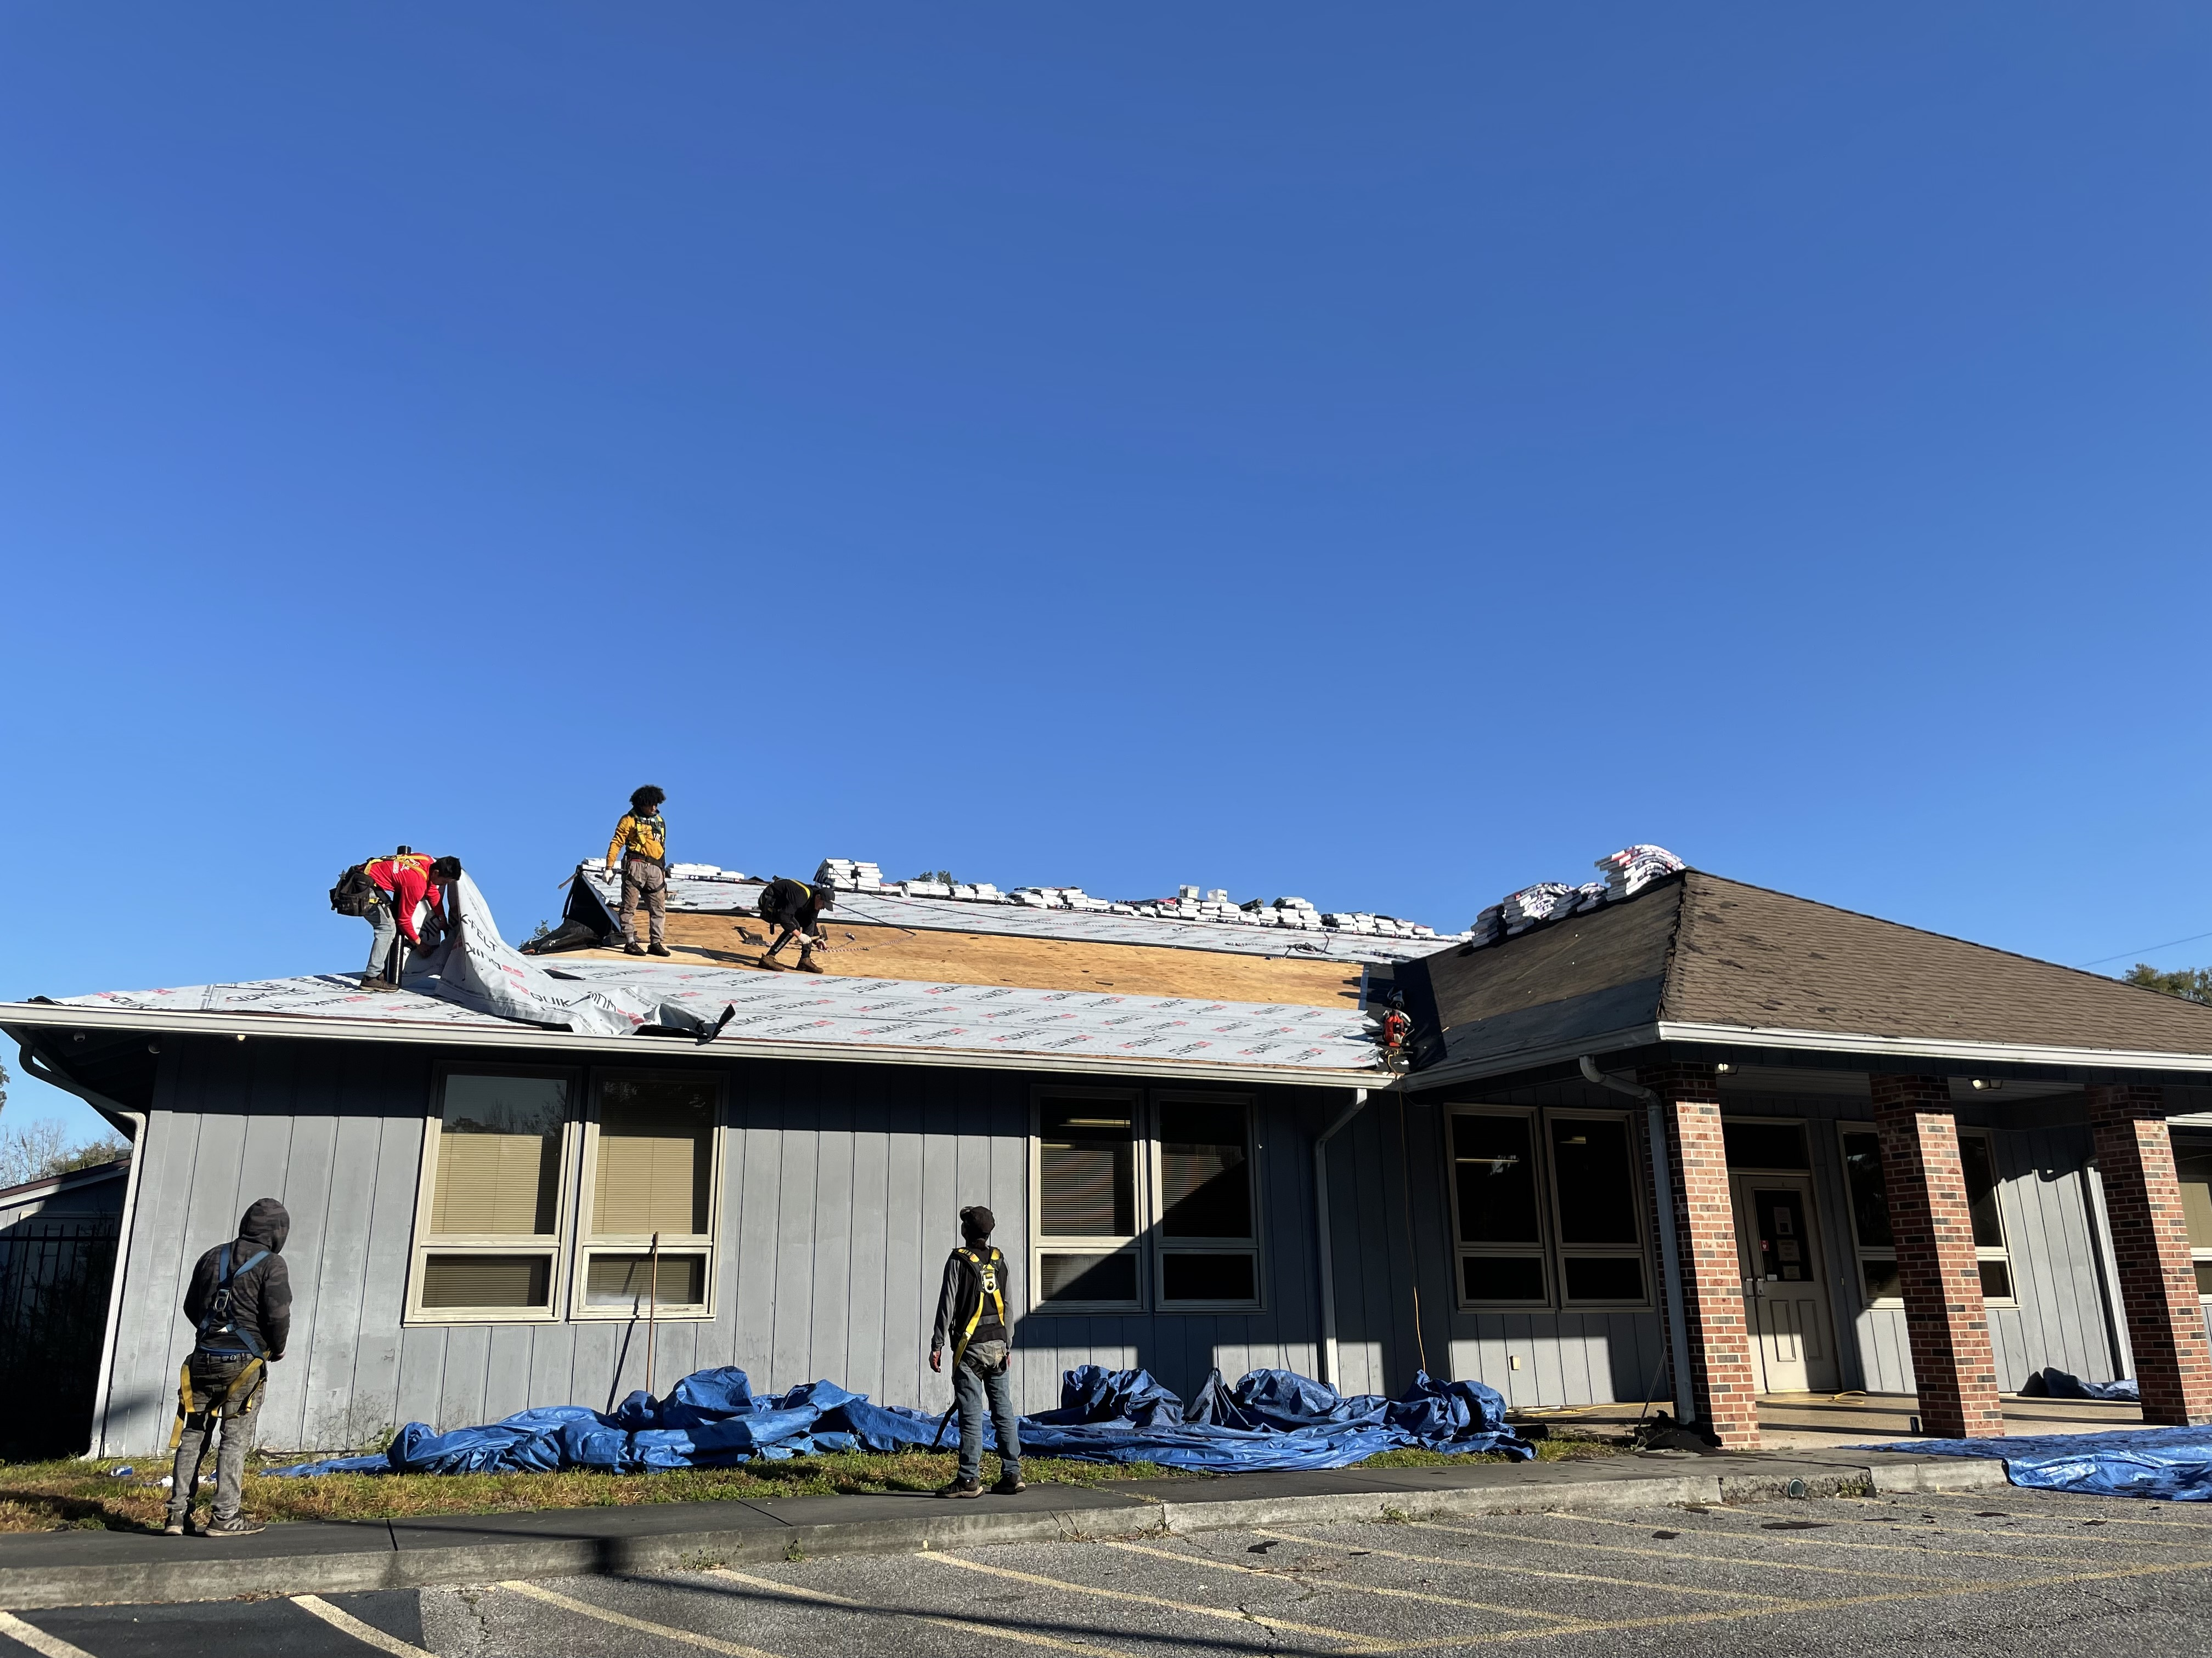
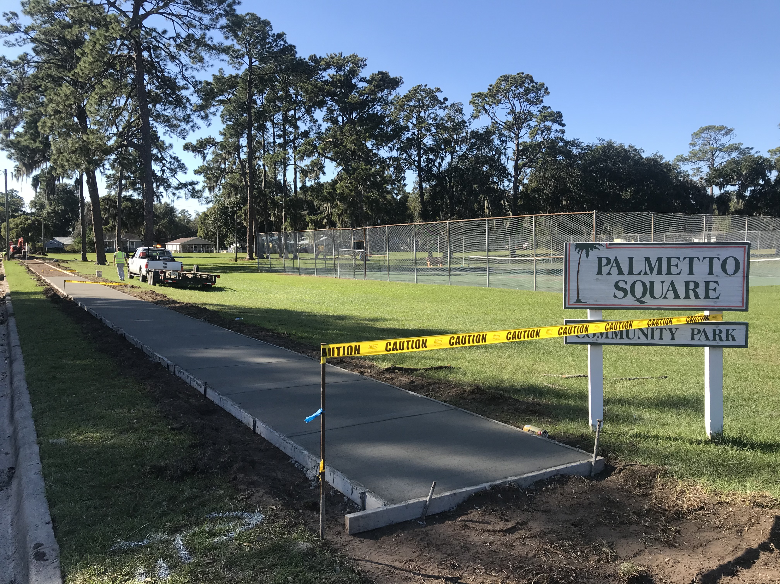

Slide 13
5) Spot Demolition
Goal description: To remove and prevent the spread of slum and blight
Allocation - $60,000 (Approxiamate)
Four or more structures to be demolished
Grantee: TBD

Slide 14
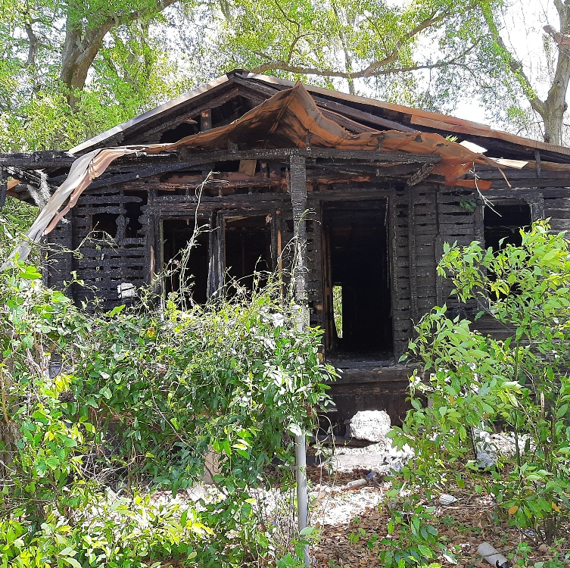
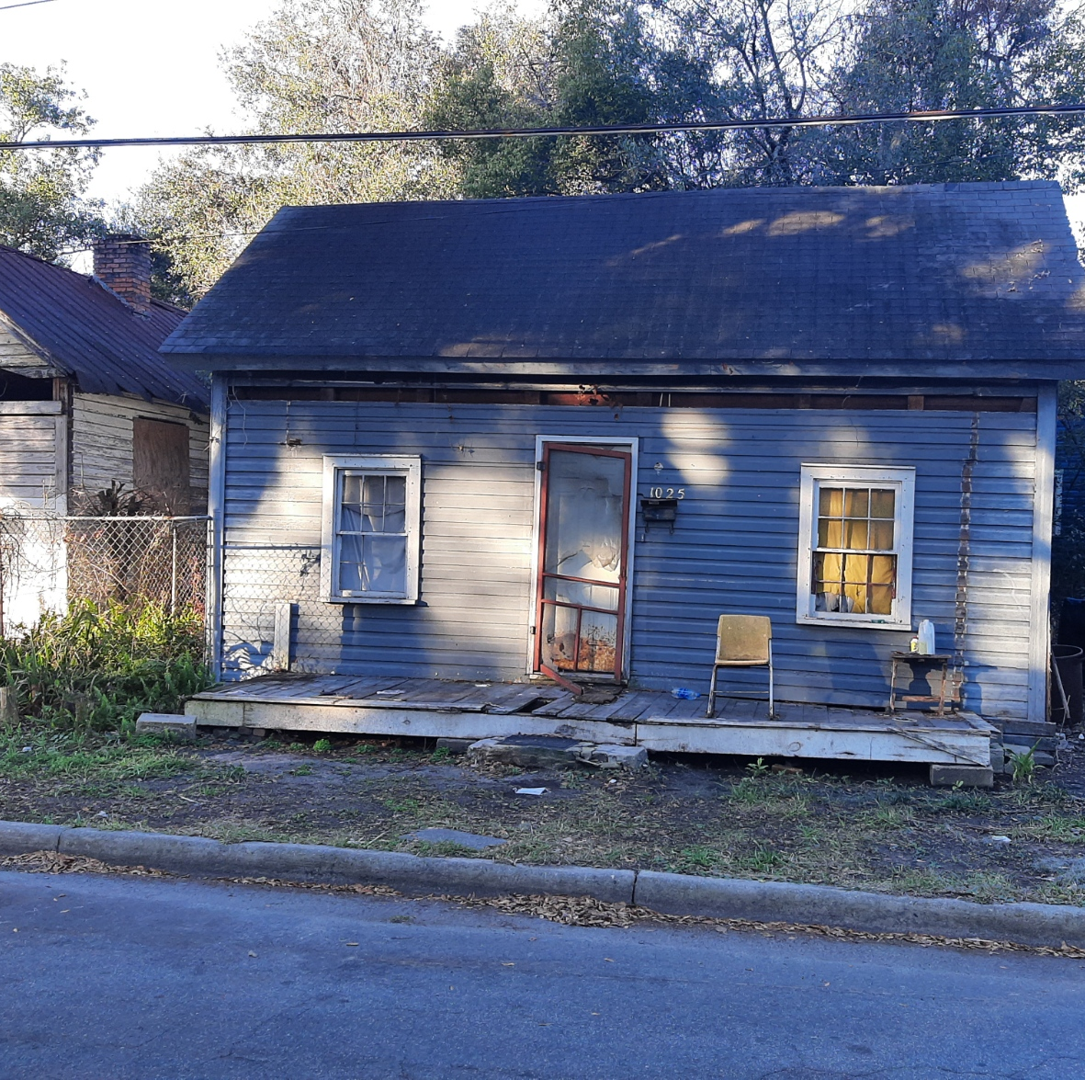

Slide 15
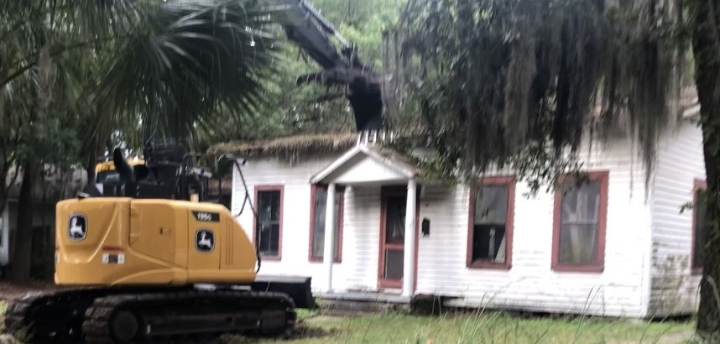

Slide 16
PROPOSED BUDGET
Housing Rehabilitation $219,000
Improve Public Facilities $ 26,000
Public Services $ 60,000
Remove Slum and Blight $ 60,000
Provide Fair Housing Education and Outreach $ 2,000
Planning and Administration of the CDBG Program $ 45,000
Total: $412,000

Slide 17
Questions or comments

Slide 18
For further information contact:
Dina Carter
Grants Program Specialist
912.267.5533
Dcarter@cityofbrunswick-ga.gov
David Bravo
Director
912.267.5584
dbravo@cityofbrunswick-ga.gov

