Slide 1
CITY OF BRUNSWICK second Public meeting for the community development block grant program (CDBG)
FY2024-2025 Action plan

Slide 2
FY 2024-2025 Action Plan
Each year the City of Brunswick prepares an Action Plan to describe to the public (and HUD) how it intends to spend its annual CDBG allocation.
FY2024-2025 CDBG Allocation: $412,914 (projected)
HUD’s fiscal year begins July 1, 2024 and ends June 30, 2025
Projects will benefit the City of Brunswick for many years

Slide 3
PROJECTED BUDGET
Minor Major Home Repair Program $227,874
Improve Public Facilities $ 8,040
Public Services $ 60,000
Remove Slum and Blight $ 70,000
Provide Fair Housing Education and Outreach $ 2,000
Planning and Administration of the CDBG Program $ 47,000
Total: $412,914

Slide 4
Projects, allocations and goals

Slide 5
1.) Planning and Administration
Goal description: To cover administrative expenses such as salaries, equipment, etc
Allocation - $47,000
The allocation pays for a portion of salaries; the city covers the remaining balance
Grantee: City of Brunswick

Slide 6
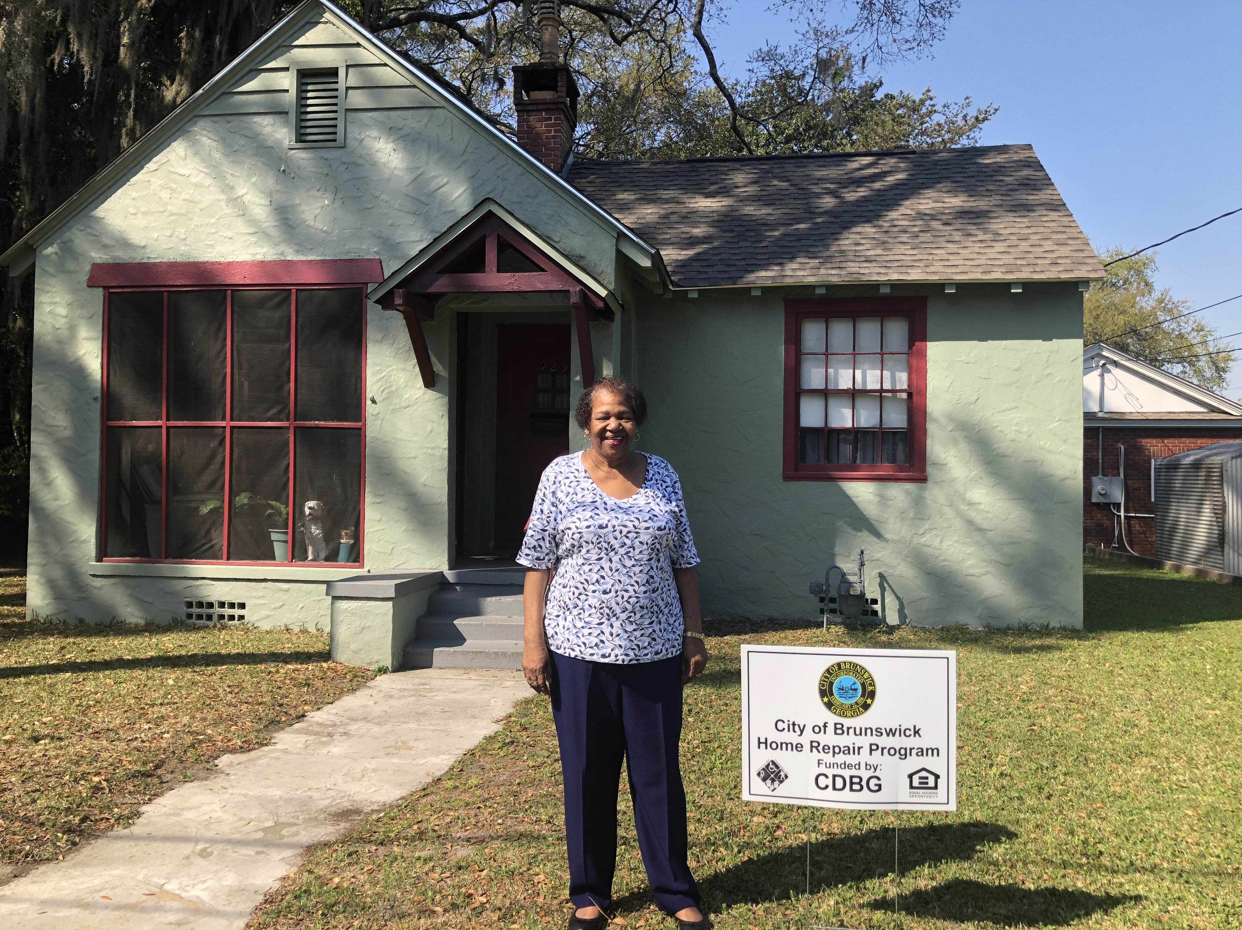

Slide 7
2.) Minor Major Home Repair Program (MMH)
Goal description: To preserve and rehabilitate safe, healthy and affordable housing (single and multi-family)
Allocation - $227,874
7 - 10 housing units to be rehabilitated by replacing roofs, HVAC units, windows, bathrooms, ADA ramps, plumbing, electrical, etc.
Grantees: Open to low-to moderate-income homeowners within city limits

Slide 8
CDBG Advisory Board Committee
Each year, the City of Brunswick CDBG Advisory Board members meet to review the proposals for non-profit agencies that are seeking funding for public services and public facilities
The committee works to promote positive neighborhood values and a greater sense of neighborhood cohesiveness
Their time and dedication truly reflects their roles and commitment to our community

Slide 9
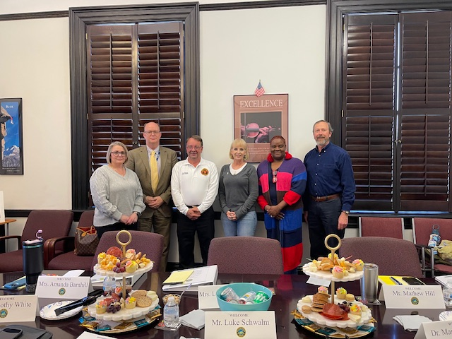
Left – Right:
Amanda Barnhill, Brunswick Police Department
Luke Schwalm, Brunswick-Glynn Joint Water and Sewer
Chief Tim White, Brunswick Fire Department
Lea King-Badyna, Keep Golden Isles Beautiful
Dr. Markisha Butler, U.S. Department of Labor
Mathew Hill, Downtown Development Authority

Slide 11
3.) Public Services
Goal description: To support youth and homeless services, senior citizens, after-school and summer programs
Allocation - $60,000
Seven non-profits:
Brunswick Rocks $ 8,000
Coast Outreach Academies $12,000
Foster Love Ministries $ 5,000
Rebuilding Together of Glynn County $ 8,000
Roosevelt Lawrence Community Youth Center $16,000
Safe Harbor $ 8,000
Youth Enrichment Learning Center $ 3,000

Slide 12
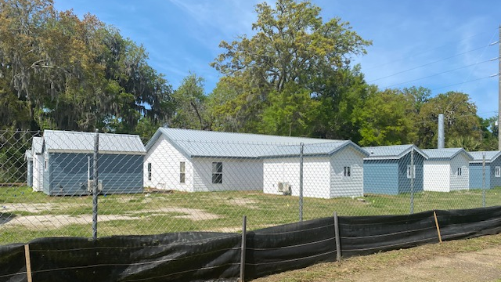

Slide 13
4) Public Facilities
Goal description: To provide infrastructure improvements to a program that provides a safe environment for homeless veterans
Allocation - $8,040
One public facility project:
Golden Isles Veterans Village, Inc.

Slide 14
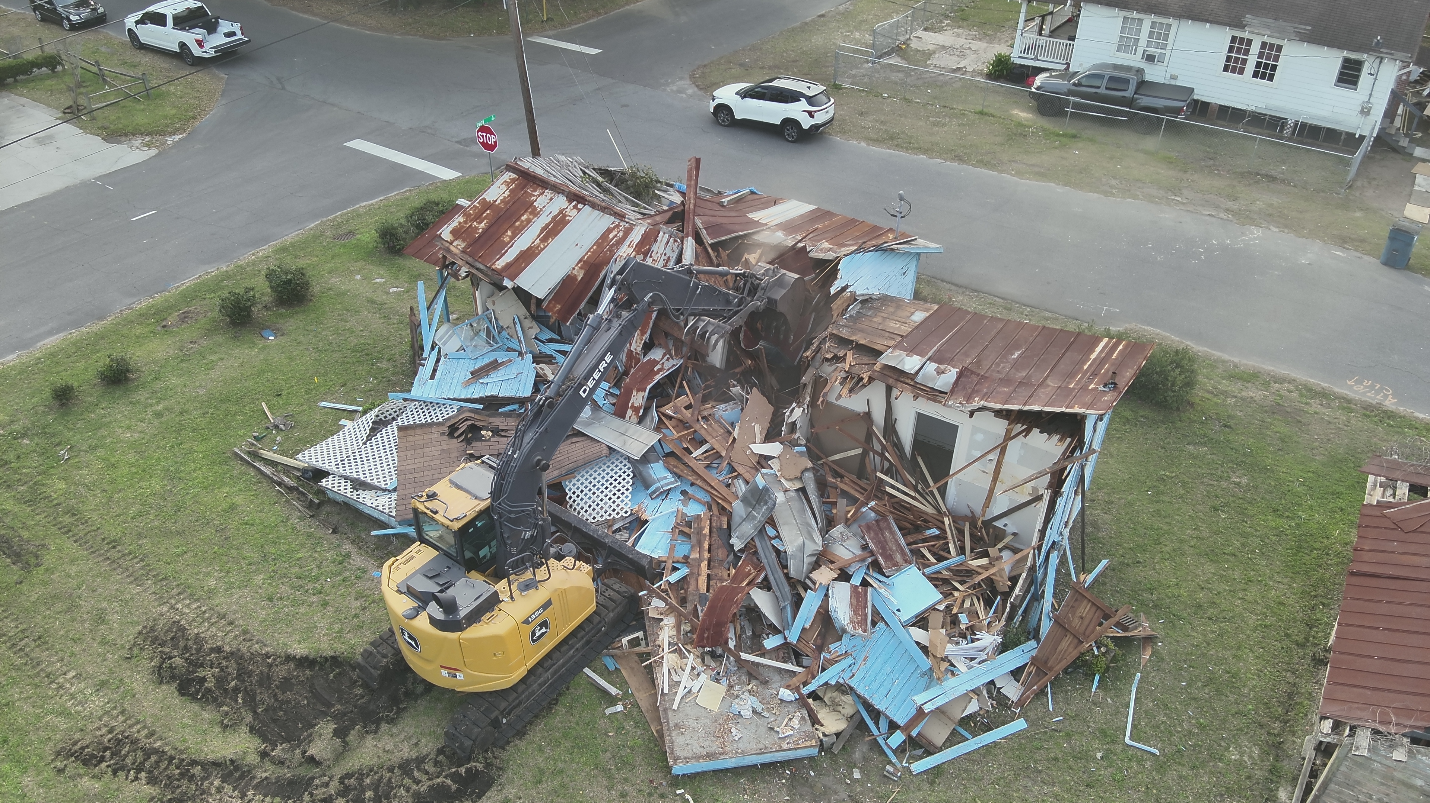

Slide 15
5.) Remove Slum and Blight (Spot Demolition)
Goal description: To remove and prevent the spread of slum and blight
Allocation - $70,000
Five to seven buildings to be demolished
Grantees: Open to property owners within the city limits

Slide 16
PROJECTED BUDGET
Minor Major Home Repair Program $227,874
Improve Public Facilities $ 8,040
Public Services $ 60,000
Remove Slum and Blight $ 70,000
Provide Fair Housing Education and Outreach $ 2,000
Planning and Administration of the CDBG Program $ 47,000
Total: $412,914

Slide 17
Questions or comments

Slide 18
For further information contact:
David Bravo
Director
912.267.5584
dbravo@cityofbrunswick-ga.gov
Dina Carter
Grants Program Specialist
912.267.5533
dcarter@cityofbrunswick-ga.gov

